Slide 1
Schemas, Validation, and Password Hashing
SoftUni Team
Technical Trainers
Software University
https://softuni.bg

Slide 2
Table of Contents
Schemas
Validation
Hashing
2

Slide 3
Have a Question?
sli.do
#Flask

Slide 4

What is a schema?

Slide 5
Definition
A schema is a tool for validating Python data structures, such as those obtained from config-files, forms, external services, or command-line parsing, converted from JSON/YAML (or something else) to Python data-typesIt contains the essential fields and behaviors of the data you're storing
Used to convert objects to and from Python data types
Documentation link - here

Slide 6
Marshmallow schema
A simple class that should inherit Schema class from Marshmallow
They can be extended from other classes
from marshmallow import Schema, fields
class BaseUserSchema(Schema):
email = fields.Email()
full_name = fields.String()
class UserSignInSchema(BaseUserSchema):
password = fields.String())

Slide 7
Simple usage
class SignUp(Resource):
def post(self):
data = request.get_json()
schema = UserSignInSchema()
errors = schema.validate(data)
if not errors:
db.session.add(User(**data))
db.session.commit()
return 201, data

Slide 8
Nested Schemas
from marshmallow import Schema, fields
class UserSchema(Schema):
name = fields.String()
email = fields.Email()
created_at = fields.DateTime()
class BlogSchema(Schema):
title = fields.String()
author = fields.Nested(UserSchema)

Slide 9

Validation

Slide 10
Validation
Validating with Marshmallow schemas is an easy and flexible way of controlling the data that comes in with the request and the fields you want to show on the response
Marshmallow comes with pre-build fields validation such as: String, Email Integer, Fload, and etc.
Gives you the possibility to create custom fields
Pre-build validators
Custom validators

Slide 11
Validation
Build in validator
class UserSignInSchema(BaseUserSchema):
password = fields.String(
required=True,
validate=validate.And(
validate.Length(min=8, max=20),
validate_password))
Type of the field
A value is mandatory
Custom validator function

Slide 12
Checking Validity
Checks for errors and returns an errors object if necessary
We can handle errors differently – send a message to the user, change the data or throw an error
schema = UserSignInSchema()
errors = schema.validate(data)
if not errors:
...

Slide 13
Advanced Usage
def validate_schema(schema_name):
def decorator(f):
@wraps(f)
def decorated_function(*args, **kwargs):
schema = schema_name()
errors = schema.validate(request.get_json())
if errors:
abort(400, errors=errors)
return f(*args, **kwargs)
return decorated_function
return decorator
class SignUp(Resource):
@validate_schema(UserSignInSchema)
def post(self):
...

Slide 14
Hashing
$5$MnfsQ4iN$ZMTppKN16y/tIsUYs/obHlhdP.Os80yXhTurpBMUbA5 $5$rounds=…

Slide 15
Why and what?
For security reasons, you may want to store passwords in hashed form
This guards against the possibility that someone who gains unauthorized access to the database can retrieve the passwords of every user in the system
Hashing performs a one-way transformation on a password, turning the password into another String, called the hashed password
"One-way" means that it is practically impossible to go the other way - to turn the hashed password back into the original password.

Slide 16
Hashing
There are several mathematically complex hashing algorithms that fulfill these needs
The hashed password value is not encrypted before it is stored in the database
When a member attempts to log in, the Personalization module takes the supplied password, performs a similar one-way hash, and compares it to the database value
If the passwords match, then login is successful

Slide 17
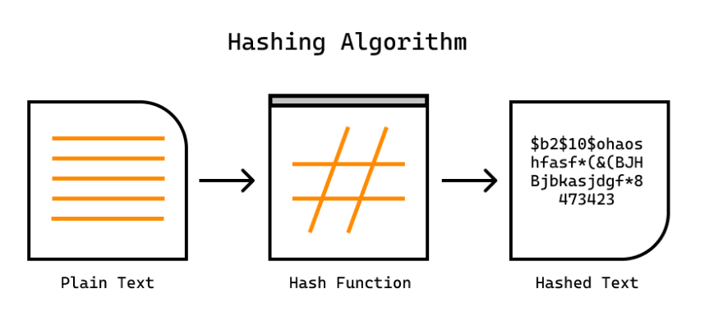
Example with werkzeug
from werkzeug.security import generate_password_hash
generate_password_hash(data['password'], method='sha256’)
…
check_password_hash(user.password, data["password"])

Slide 18

Live Demo

Slide 19
Questions?
Notes:
19

Slide 20












SoftUni Diamond Partners

Slide 21


Educational Partners

Slide 22
Trainings @ Software University (SoftUni)
Software University – High-Quality Education, Profession and Job for Software Developers
softuni.bg, softuni.org
Software University Foundation
softuni.foundation
Software University @ Facebook
facebook.com/SoftwareUniversity
Software University Forums
forum.softuni.bg
22
Notes:
22

Slide 23

License
This course (slides, examples, demos, exercises, homework, documents, videos and other assets) is copyrighted content
Unauthorized copy, reproduction or use is illegal
© SoftUni – https://softuni.org
© Software University – https://softuni.bg
Notes:
23

